Slide 1
CPU软渲染 路径追踪渲染器
向光源采样 B站：HeaoYe

Slide 2
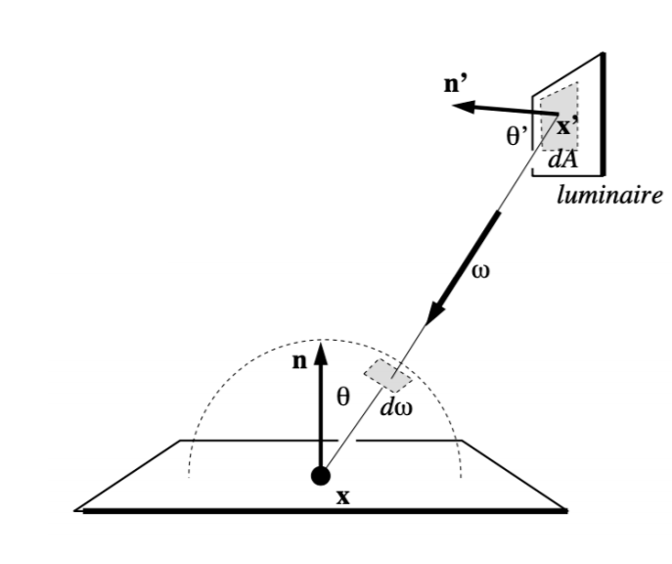

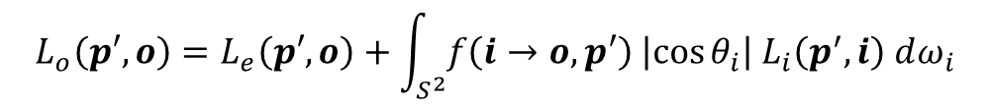
向光源采样
相机发射光线
击中场景上一点
根据BSDF选择光线方向
发射新的光线
相机发射光线
击中场景上一点
根据场景光源选择光源上一点
发射新的光线
$$L_{o}\left(p′, o\right)=L_{e}\left(p′,o\right)+\int_{S^{2}}{f\left(i→o, p′\right) \left|\cos{θ_{i}}\right| L_{i}\left(p^{′}, i\right) dω_{i}}$$
$$？$$

Slide 3
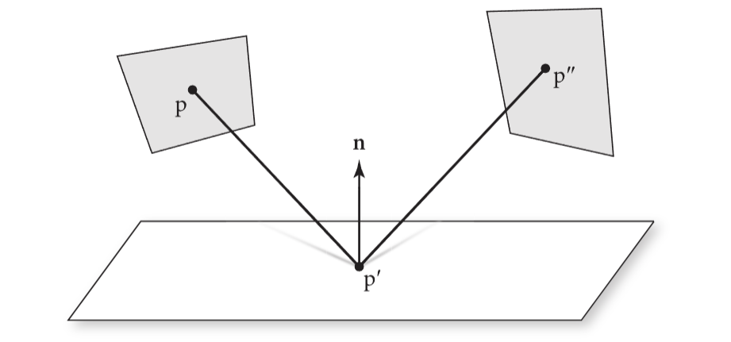
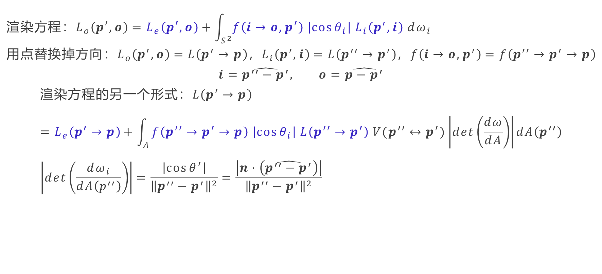
渲染方程变换
$$渲染方程：L_{o}\left(p′, o\right)=L_{e}\left(p′,o\right)+\int_{S^{2}}{f\left(i→o, p′\right) \left|\cos{θ_{i}}\right| L_{i}\left(p^{′}, i\right) dω_{i}} \\ 用点替换掉方向：L_{o}\left(p^{′}, o\right)=L\left(p^{′}→p\right)，L_{i}\left(p^{′}, i\right)=L\left(p^{′′}→p^{′}\right)，f\left(i→o, p^{′}\right)=f\left(p^{′′}→p^{′}→p\right)$$
$$i=\hat{p^{′′}−p^{′}}, o=\hat{p−p^{′}}$$
$$渲染方程的另一个形式：L\left(p^{′}→p\right)=L_{e}\left(p^{′}→p\right)+\int_{A}{f\left(p^{′′}→p^{′}→p\right) \left|\cos{θ_{i}}\right| L\left(p^{′′}→p^{′}\right) V(p^{′′}↔p^{′})\left|det\left(\frac{dω}{dA}\right)\right|dA\left(p^{′′}\right)} \\ \left|det\left(\frac{dω_{i}}{dA\left(p^{′′}\right)}\right)\right|=\frac{\left|\cos{θ^{′}}\right|}{{\left\|p^{′′}−p^{′}\right\|}^{2}}=\frac{\left|n⋅\left(\hat{p^{′′}−p^{′}}\right)\right|}{{\left\|p^{′′}−p^{′}\right\|}^{2}}$$

Slide 4


渲染方程变换
$$L\left(p^{′}→p\right) \\ =L_{e}\left(p^{′}→p\right)+\int_{A}{f\left(p^{′′}→p^{′}→p\right) \left|cosθ_{i}\right| L\left(p^{′′}→p^{′}\right) V(p^{′′}↔p^{′})\left|det\left(\frac{dω_{i}}{dA\left(p^{′′}\right)}\right)\right|dA\left(p^{′′}\right)} \\ =L_{e}\left(p^{′}→p\right)+\int_{A}{f\left(p^{′′}→p^{′}→p\right) L\left(p^{′′}→p^{′}\right) G\left(p^{′′}↔p^{′}\right) dA\left(p^{′′}\right)}$$
$$G\left(p^{′′}↔p^{′}\right) \\ =\left|cosθ_{i}\right| V\left(p^{′′}↔p^{′}\right)\left|det\left(\frac{dω_{i}}{dA\left(p^{′′}\right)}\right)\right| \\ =\frac{\left|cosθ_{i}\right| \left|n⋅\left(\hat{p^{′′}−p^{′}}\right)\right|}{{\left\|p^{′′}−p^{′}\right\|}^{2}}V\left(p^{′′}↔p^{′}\right)$$

Slide 5
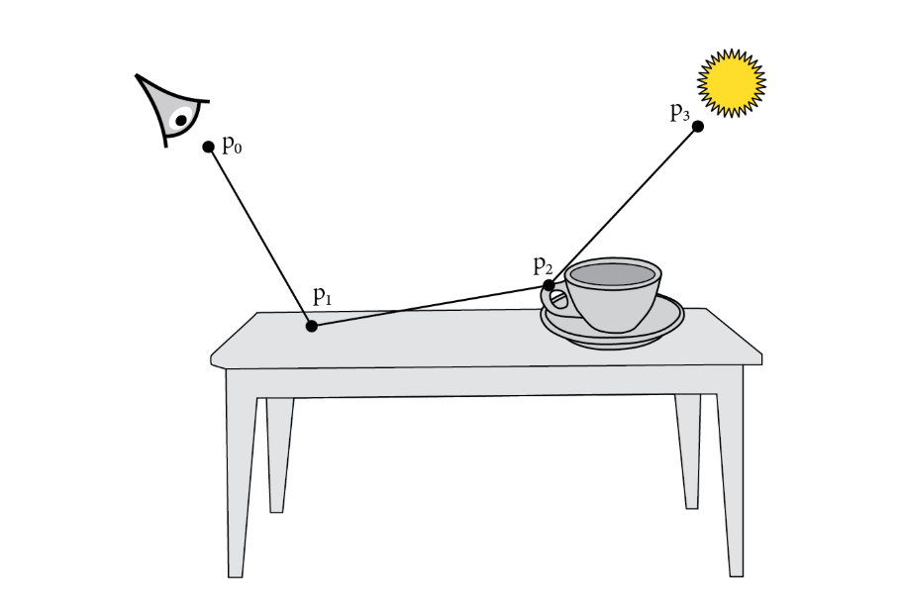
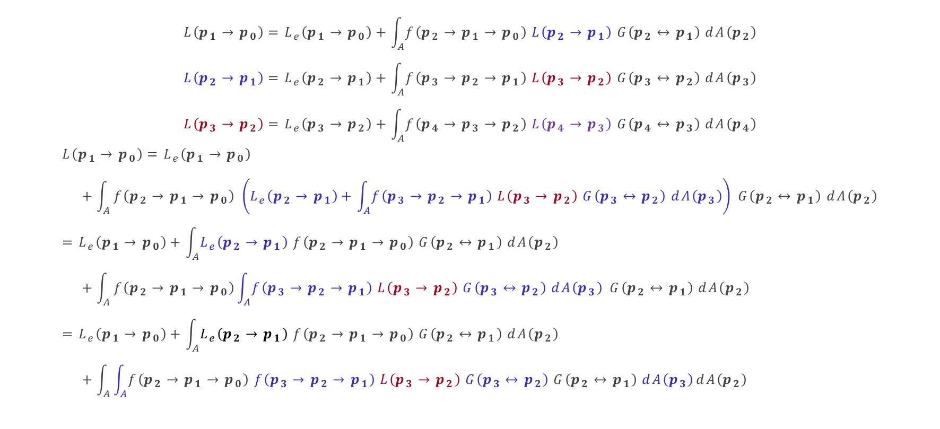
路径积分
$$L\left(p_{1}→p_{0}\right)=L_{e}\left(p_{1}→p_{0}\right)+\int_{A}{f\left(p_{2}→p_{1}→p_{0}\right) L\left(p_{2}→p_{1}\right) G\left(p_{2}↔p_{1}\right) dA\left(p_{2}\right)}$$
$$L\left(p_{2}→p_{1}\right)=L_{e}\left(p_{2}→p_{1}\right)+\int_{A}{f\left(p_{3}→p_{2}→p_{1}\right) L\left(p_{3}→p_{2}\right) G\left(p_{3}↔p_{2}\right) dA\left(p_{3}\right)}$$
$$L\left(p_{3}→p_{2}\right)=L_{e}\left(p_{3}→p_{2}\right)+\int_{A}{f\left(p_{4}→p_{3}→p_{2}\right) L\left(p_{4}→p_{3}\right) G\left(p_{4}↔p_{3}\right) dA\left(p_{4}\right)}$$
$$L\left(p_{1}→p_{0}\right)=L_{e}\left(p_{1}→p_{0}\right) \\ +\int_{A}{f\left(p_{2}→p_{1}→p_{0}\right) \left(L_{e}\left(p_{2}→p_{1}\right)+\int_{A}{f\left(p_{3}→p_{2}→p_{1}\right) L\left(p_{3}→p_{2}\right) G\left(p_{3}↔p_{2}\right) dA\left(p_{3}\right)}\right) G\left(p_{2}↔p_{1}\right) dA\left(p_{2}\right)} \\ =L_{e}\left(p_{1}→p_{0}\right)+\int_{A}{L_{e}\left(p_{2}→p_{1}\right) f\left(p_{2}→p_{1}→p_{0}\right) G\left(p_{2}↔p_{1}\right) dA\left(p_{2}\right)} \\ +\int_{A}{f\left(p_{2}→p_{1}→p_{0}\right)\int_{A}{f\left(p_{3}→p_{2}→p_{1}\right) L\left(p_{3}→p_{2}\right) G\left(p_{3}↔p_{2}\right) dA\left(p_{3}\right)} G\left(p_{2}↔p_{1}\right) dA\left(p_{2}\right)} \\ =L_{e}\left(p_{1}→p_{0}\right)+\int_{A}{L_{e}\left(p_{2}→p_{1}\right) f\left(p_{2}→p_{1}→p_{0}\right) G\left(p_{2}↔p_{1}\right) dA\left(p_{2}\right)} \\ +\int_{A}{\int_{A}{f\left(p_{2}→p_{1}→p_{0}\right) f\left(p_{3}→p_{2}→p_{1}\right) L\left(p_{3}→p_{2}\right) G\left(p_{3}↔p_{2}\right) G\left(p_{2}↔p_{1}\right) dA\left(p_{3}\right)}dA\left(p_{2}\right)}$$

Slide 6

路径积分
$$L\left(p_{3}→p_{2}\right)=L_{e}\left(p_{3}→p_{2}\right)+\int_{A}{f\left(p_{4}→p_{3}→p_{2}\right) L\left(p_{4}→p_{3}\right) G\left(p_{4}↔p_{3}\right) dA\left(p_{4}\right)}$$
$$L\left(p_{1}→p_{0}\right)=L_{e}\left(p_{1}→p_{0}\right) \\ +\int_{A}{L_{e}\left(p_{2}→p_{1}\right) f\left(p_{2}→p_{1}→p_{0}\right) G\left(p_{2}↔p_{1}\right) dA\left(p_{2}\right)} \\ +\int_{A}{\int_{A}{f\left(p_{2}→p_{1}→p_{0}\right) f\left(p_{3}→p_{2}→p_{1}\right) L\left(p_{3}→p_{2}\right) G\left(p_{3}↔p_{2}\right) G\left(p_{2}↔p_{1}\right) dA\left(p_{3}\right)}dA\left(p_{2}\right)} \\ =L_{e}\left(p_{1}→p_{0}\right) \\ +\int_{A}{L_{e}\left(p_{2}→p_{1}\right) f\left(p_{2}→p_{1}→p_{0}\right) G\left(p_{2}↔p_{1}\right) dA\left(p_{2}\right)} \\ +\int_{A}{\int_{A}{f\left(p_{2}→p_{1}→p_{0}\right) f\left(p_{3}→p_{2}→p_{1}\right) L_{e}\left(p_{3}→p_{2}\right) G\left(p_{3}↔p_{2}\right) G\left(p_{2}↔p_{1}\right) dA\left(p_{3}\right)}dA\left(p_{2}\right)} \\ +\int_{A}{\int_{A}{\int_{A}{f\left(p_{2}→p_{1}→p_{0}\right) f\left(p_{3}→p_{2}→p_{1}\right) f\left(p_{4}→p_{3}→p_{2}\right) L\left(p_{4}→p_{3}\right) G\left(p_{4}↔p_{3}\right) G\left(p_{3}↔p_{2}\right) G\left(p_{2}↔p_{1}\right) dA\left(p_{4}\right)}dA\left(p_{3}\right)}dA\left(p_{2}\right)}$$

Slide 7

路径积分
$$L\left(p_{1}→p_{0}\right)=L_{e}\left(p_{1}→p_{0}\right) \\ +\int_{A}{L_{e}\left(p_{2}→p_{1}\right) f\left(p_{2}→p_{1}→p_{0}\right) G\left(p_{2}↔p_{1}\right) dA\left(p_{2}\right)} \\ +\int_{A}{\int_{A}{f\left(p_{2}→p_{1}→p_{0}\right) f\left(p_{3}→p_{2}→p_{1}\right) L_{e}\left(p_{3}→p_{2}\right) G\left(p_{3}↔p_{2}\right) G\left(p_{2}↔p_{1}\right) dA\left(p_{3}\right)}dA\left(p_{2}\right)} \\ +\int_{A}{\int_{A}{\int_{A}{f\left(p_{2}→p_{1}→p_{0}\right) f\left(p_{3}→p_{2}→p_{1}\right) f\left(p_{4}→p_{3}→p_{2}\right) L_{e}\left(p_{4}→p_{3}\right) G\left(p_{4}↔p_{3}\right) G\left(p_{3}↔p_{2}\right) G\left(p_{2}↔p_{1}\right) dA\left(p_{4}\right)}dA\left(p_{3}\right)}dA\left(p_{2}\right)} \\ +…$$
$$L\left(p_{1}→p_{0}\right)=\sum_{i=1}^{+∞}{P({\overline{p}}_{i})}$$
$$包含n+1个顶点的所有路径：{\overline{p}}_{n}=p_{0},p_{1},…,p_{n}；P\left({\overline{p}}_{n}\right)：路径{\overline{p}}_{n}贡献的光照$$
$$P\left({\overline{p}}_{n}\right)=\int_{A}{\int_{A}{…\int_{A}{L_{e}\left(p_{n}→p_{n−1}\right) ∗\left(\prod_{i=1}^{n−1}{f\left(p_{i+1}→p_{i}→p_{i−1}\right) G(p_{i+1}}↔p_{i})\right)}dA(p_{2})}…dA(p_{n})}$$
$$T\left({\overline{p}}_{n}\right)=\prod_{i=1}^{n−1}{f\left(p_{i+1}→p_{i}→p_{i−1}\right) G(p_{i+1}}↔p_{i})$$

Slide 8

求解路径积分
(1) 俄罗斯轮盘赌
$$L\left(p_{1}→p_{0}\right)=\sum_{i=1}^{+∞}{P({\overline{p}}_{i})} \\ \sum_{i=1}^{+∞}{P({\overline{p}}_{i})}=P\left({\overline{p}}_{1}\right)+\left\{\begin{aligned}\frac{\sum_{i=2}^{+∞}{P\left({\overline{p}}_{i}\right)}}{q}, with prob q \\ 0, otherwise\end{aligned}\right.$$
$$L\left(p_{1}→p_{0}\right)=P\left({\overline{p}}_{1}\right)+\frac{1}{q}(P\left({\overline{p}}_{2}\right)+\frac{1}{q}(P\left({\overline{p}}_{3}\right)+\frac{1}{q}(P\left({\overline{p}}_{4}\right)+…$$

Slide 9
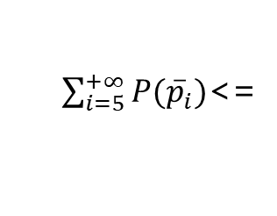
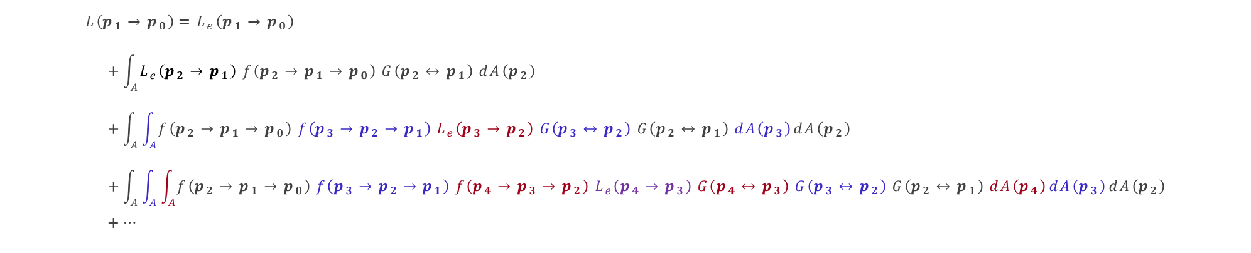




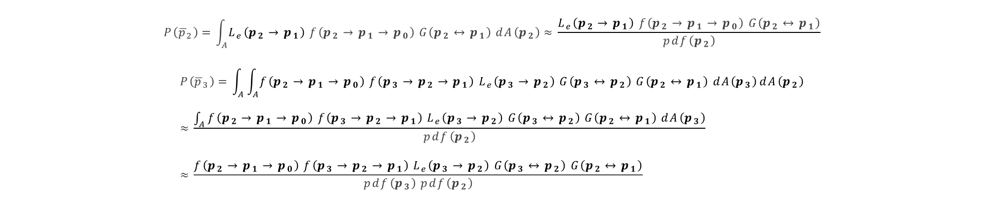
求解路径积分
(2) 蒙特卡洛估计
$$L\left(p_{1}→p_{0}\right)=L_{e}\left(p_{1}→p_{0}\right) \\ +\int_{A}{L_{e}\left(p_{2}→p_{1}\right) f\left(p_{2}→p_{1}→p_{0}\right) G\left(p_{2}↔p_{1}\right) dA\left(p_{2}\right)} \\ +\int_{A}{\int_{A}{f\left(p_{2}→p_{1}→p_{0}\right) f\left(p_{3}→p_{2}→p_{1}\right) L_{e}\left(p_{3}→p_{2}\right) G\left(p_{3}↔p_{2}\right) G\left(p_{2}↔p_{1}\right) dA\left(p_{3}\right)}dA\left(p_{2}\right)} \\ +\int_{A}{\int_{A}{\int_{A}{f\left(p_{2}→p_{1}→p_{0}\right) f\left(p_{3}→p_{2}→p_{1}\right) f\left(p_{4}→p_{3}→p_{2}\right) L_{e}\left(p_{4}→p_{3}\right) G\left(p_{4}↔p_{3}\right) G\left(p_{3}↔p_{2}\right) G\left(p_{2}↔p_{1}\right) dA\left(p_{4}\right)}dA\left(p_{3}\right)}dA\left(p_{2}\right)} \\ +…$$
=> $P\left({\overline{p}}_{1}\right)$
$P\left({\overline{p}}_{2}\right)$ <=
$P\left({\overline{p}}_{3}\right)$ <=
$P\left({\overline{p}}_{4}\right)$ <=
$\sum_{i=5}^{+∞}{P({\overline{p}}_{i})}$<=
$$P\left({\overline{p}}_{2}\right)=\int_{A}{L_{e}\left(p_{2}→p_{1}\right) f\left(p_{2}→p_{1}→p_{0}\right) G\left(p_{2}↔p_{1}\right) dA\left(p_{2}\right)}≈\frac{L_{e}\left(p_{2}→p_{1}\right) f\left(p_{2}→p_{1}→p_{0}\right) G\left(p_{2}↔p_{1}\right)}{pdf\left(p_{2}\right)}$$
$$P\left({\overline{p}}_{3}\right)=\int_{A}{\int_{A}{f\left(p_{2}→p_{1}→p_{0}\right) f\left(p_{3}→p_{2}→p_{1}\right) L_{e}\left(p_{3}→p_{2}\right) G\left(p_{3}↔p_{2}\right) G\left(p_{2}↔p_{1}\right) dA\left(p_{3}\right)}dA\left(p_{2}\right)}≈\frac{\int_{A}{f\left(p_{2}→p_{1}→p_{0}\right) f\left(p_{3}→p_{2}→p_{1}\right) L_{e}\left(p_{3}→p_{2}\right) G\left(p_{3}↔p_{2}\right) G\left(p_{2}↔p_{1}\right) dA\left(p_{3}\right)}}{pdf\left(p_{2}\right)}≈\frac{f\left(p_{2}→p_{1}→p_{0}\right) f\left(p_{3}→p_{2}→p_{1}\right) L_{e}\left(p_{3}→p_{2}\right) G\left(p_{3}↔p_{2}\right) G\left(p_{2}↔p_{1}\right)}{pdf\left(p_{3}\right) pdf\left(p_{2}\right)}$$

Slide 10
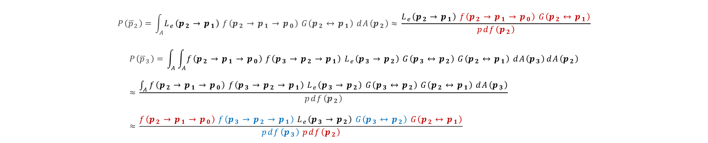

求解路径积分
(3) 蒙特卡洛采样点选择
$$P\left({\overline{p}}_{2}\right)=\int_{A}{L_{e}\left(p_{2}→p_{1}\right) f\left(p_{2}→p_{1}→p_{0}\right) G\left(p_{2}↔p_{1}\right) dA\left(p_{2}\right)}≈\frac{L_{e}\left(p_{2}→p_{1}\right) f\left(p_{2}→p_{1}→p_{0}\right) G\left(p_{2}↔p_{1}\right)}{pdf\left(p_{2}\right)}$$
$$P\left({\overline{p}}_{3}\right)=\int_{A}{\int_{A}{f\left(p_{2}→p_{1}→p_{0}\right) f\left(p_{3}→p_{2}→p_{1}\right) L_{e}\left(p_{3}→p_{2}\right) G\left(p_{3}↔p_{2}\right) G\left(p_{2}↔p_{1}\right) dA\left(p_{3}\right)}dA\left(p_{2}\right)}≈\frac{\int_{A}{f\left(p_{2}→p_{1}→p_{0}\right) f\left(p_{3}→p_{2}→p_{1}\right) L_{e}\left(p_{3}→p_{2}\right) G\left(p_{3}↔p_{2}\right) G\left(p_{2}↔p_{1}\right) dA\left(p_{3}\right)}}{pdf\left(p_{2}\right)}≈\frac{f\left(p_{2}→p_{1}→p_{0}\right) f\left(p_{3}→p_{2}→p_{1}\right) L_{e}\left(p_{3}→p_{2}\right) G\left(p_{3}↔p_{2}\right) G\left(p_{2}↔p_{1}\right)}{pdf\left(p_{3}\right) pdf\left(p_{2}\right)}$$
增量路径构建：在对$P\left({\overline{p}}_{3}\right)$进行蒙特卡洛估计时，路径${\overline{p}}_{3}$的$(p_{0},p_{1},p_{2})$将会复用路径${\overline{p}}_{2}$，仅采样去$p_{3}$。
这样做虽然降低了对$P\left({\overline{p}}_{i}\right)$蒙特卡洛估计时的独立性，但是由于复用了之前的采样点，大幅增加了估计器速度，所以总体上可以提升估计器的效率。

Slide 11

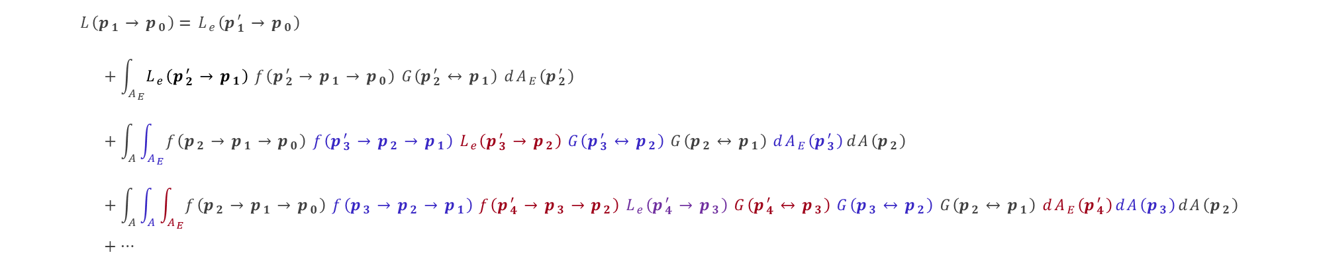
三大问题？（采样的域）
$$L\left(p_{1}→p_{0}\right)=L_{e}\left(p_{1}→p_{0}\right) \\ +\int_{A}{L_{e}\left(p_{2}→p_{1}\right) f\left(p_{2}→p_{1}→p_{0}\right) G\left(p_{2}↔p_{1}\right) dA\left(p_{2}\right)} \\ +\int_{A}{\int_{A}{f\left(p_{2}→p_{1}→p_{0}\right) f\left(p_{3}→p_{2}→p_{1}\right) L_{e}\left(p_{3}→p_{2}\right) G\left(p_{3}↔p_{2}\right) G\left(p_{2}↔p_{1}\right) dA\left(p_{3}\right)}dA\left(p_{2}\right)} \\ +\int_{A}{\int_{A}{\int_{A}{f\left(p_{2}→p_{1}→p_{0}\right) f\left(p_{3}→p_{2}→p_{1}\right) f\left(p_{4}→p_{3}→p_{2}\right) L_{e}\left(p_{4}→p_{3}\right) G\left(p_{4}↔p_{3}\right) G\left(p_{3}↔p_{2}\right) G\left(p_{2}↔p_{1}\right) dA\left(p_{4}\right)}dA\left(p_{3}\right)}dA\left(p_{2}\right)} \\ +…$$
$$A：场景所有物体(包括光源)表面面积； A_{E}：场景所有光源表面面积$$
$$L\left(p_{1}→p_{0}\right)=L_{e}\left(p_{1}^{′}→p_{0}\right) \\ +\int_{A_{E}}{L_{e}\left(p_{2}^{′}→p_{1}\right) f\left(p_{2}^{′}→p_{1}→p_{0}\right) G\left(p_{2}^{′}↔p_{1}\right) dA_{E}\left(p_{2}^{′}\right)} \\ +\int_{A}{\int_{A_{E}}{f\left(p_{2}→p_{1}→p_{0}\right) f\left(p_{3}^{′}→p_{2}→p_{1}\right) L_{e}\left(p_{3}^{′}→p_{2}\right) G\left(p_{3}^{′}↔p_{2}\right) G\left(p_{2}↔p_{1}\right) dA_{E}\left(p_{3}^{′}\right)}dA\left(p_{2}\right)} \\ +\int_{A}{\int_{A}{\int_{A_{E}}{f\left(p_{2}→p_{1}→p_{0}\right) f\left(p_{3}→p_{2}→p_{1}\right) f\left(p_{4}^{′}→p_{3}→p_{2}\right) L_{e}\left(p_{4}^{′}→p_{3}\right) G\left(p_{4}^{′}↔p_{3}\right) G\left(p_{3}↔p_{2}\right) G\left(p_{2}↔p_{1}\right) dA_{E}\left(p_{4}^{′}\right)}dA\left(p_{3}\right)}dA\left(p_{2}\right)} \\ +…$$

Slide 12



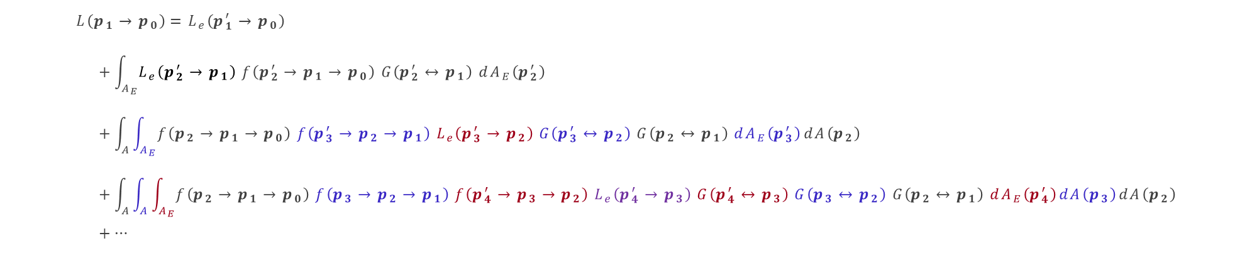















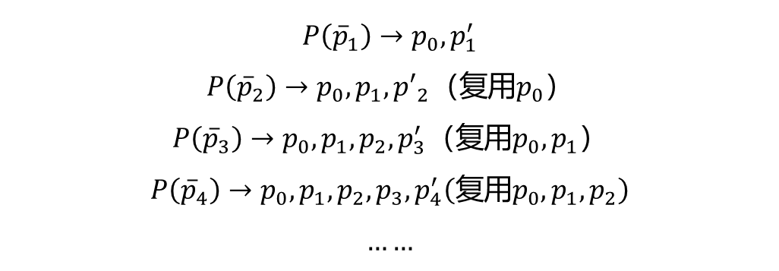
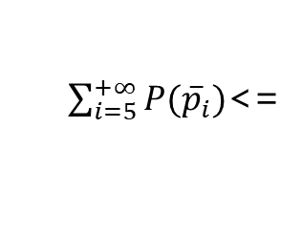


三大问题？ （如何增量构建路径）
$$L\left(p_{1}→p_{0}\right)=L_{e}\left(p_{1}^{′}→p_{0}\right) \\ +\int_{A_{E}}{L_{e}\left(p_{2}^{′}→p_{1}\right) f\left(p_{2}^{′}→p_{1}→p_{0}\right) G\left(p_{2}^{′}↔p_{1}\right) dA_{E}\left(p_{2}^{′}\right)} \\ +\int_{A}{\int_{A_{E}}{f\left(p_{2}→p_{1}→p_{0}\right) f\left(p_{3}^{′}→p_{2}→p_{1}\right) L_{e}\left(p_{3}^{′}→p_{2}\right) G\left(p_{3}^{′}↔p_{2}\right) G\left(p_{2}↔p_{1}\right) dA_{E}\left(p_{3}^{′}\right)}dA\left(p_{2}\right)} \\ +\int_{A}{\int_{A}{\int_{A_{E}}{f\left(p_{2}→p_{1}→p_{0}\right) f\left(p_{3}→p_{2}→p_{1}\right) f\left(p_{4}^{′}→p_{3}→p_{2}\right) L_{e}\left(p_{4}^{′}→p_{3}\right) G\left(p_{4}^{′}↔p_{3}\right) G\left(p_{3}↔p_{2}\right) G\left(p_{2}↔p_{1}\right) dA_{E}\left(p_{4}^{′}\right)}dA\left(p_{3}\right)}dA\left(p_{2}\right)} \\ +…$$
=> $P\left({\overline{p}}_{1}\right)$
$P\left({\overline{p}}_{2}\right)$ <=
$P\left({\overline{p}}_{3}\right)$ <=
$P\left({\overline{p}}_{4}\right)$ <=
$\sum_{i=5}^{+∞}{P({\overline{p}}_{i})}$<=
$$L=P\left({\overline{p}}_{1}\right)+…$$
$$+P\left({\overline{p}}_{2}\right)$$
$$P\left({\overline{p}}_{1}\right)→p_{0},p_{1}^{′}$$
$$P\left({\overline{p}}_{2}\right)→p_{0},p_{1},{p′}_{2}（复用p_{0}）$$
$$P\left({\overline{p}}_{3}\right)→p_{0},p_{1},p_{2},p_{3}^{′}（复用p_{0},p_{1}）$$
$$P\left({\overline{p}}_{4}\right)→p_{0},p_{1},p_{2},p_{3},p_{4}^{′}（复用p_{0},p_{1},p_{2}）$$
$$……$$
$$p_{2}^{′}$$
$$+P\left({\overline{p}}_{3}\right)$$
$$p_{0}$$
$$p_{3}^{′}$$
$$+P\left({\overline{p}}_{4}\right)$$
$$p_{1}$$
$$p_{4}^{′}$$
$$+P\left({\overline{p}}_{5}\right)$$
$$p_{2}$$
$$p_{5}^{′}$$
$$p_{3}$$
$$p_{4}$$
$$……$$
$$p_{5}$$

Slide 13
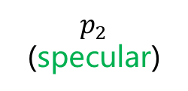
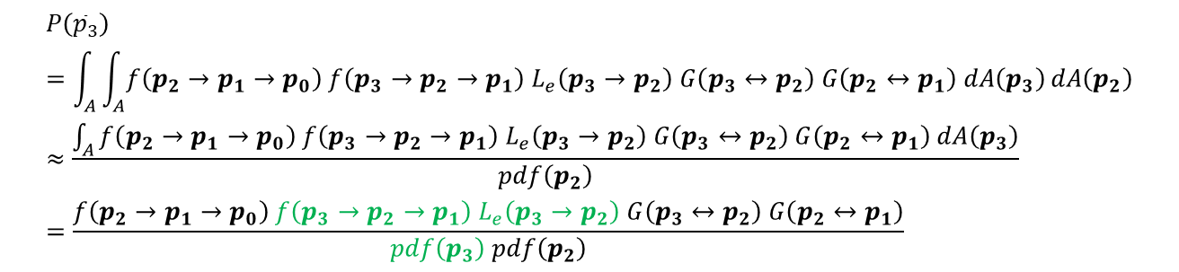


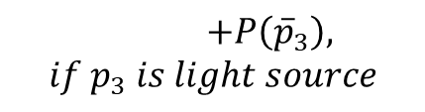
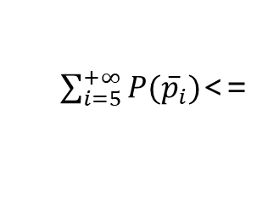

三大问题？ （应对镜面反射/折射）
$$L\left(p_{1}→p_{0}\right)=L_{e}\left(p_{1}^{′}→p_{0}\right) \\ +\int_{A_{E}}{L_{e}\left(p_{2}^{′}→p_{1}\right) f\left(p_{2}^{′}→p_{1}→p_{0}\right) G\left(p_{2}^{′}↔p_{1}\right) dA_{E}\left(p_{2}^{′}\right)} \\ +\int_{A}{\int_{A_{E}}{f\left(p_{2}→p_{1}→p_{0}\right) f\left(p_{3}^{′}→p_{2}→p_{1}\right) L_{e}\left(p_{3}^{′}→p_{2}\right) G\left(p_{3}^{′}↔p_{2}\right) G\left(p_{2}↔p_{1}\right) dA_{E}\left(p_{3}^{′}\right)}dA\left(p_{2}\right)} \\ +\int_{A}{\int_{A}{\int_{A_{E}}{f\left(p_{2}→p_{1}→p_{0}\right) f\left(p_{3}→p_{2}→p_{1}\right) f\left(p_{4}^{′}→p_{3}→p_{2}\right) L_{e}\left(p_{4}^{′}→p_{3}\right) G\left(p_{4}^{′}↔p_{3}\right) G\left(p_{3}↔p_{2}\right) G\left(p_{2}↔p_{1}\right) dA_{E}\left(p_{4}^{′}\right)}dA\left(p_{3}\right)}dA\left(p_{2}\right)} \\ +…$$
=> $P\left({\overline{p}}_{1}\right)$
$P\left({\overline{p}}_{2}\right)$ <=
$P\left({\overline{p}}_{3}\right)$ <=
$P\left({\overline{p}}_{4}\right)$ <=
$\sum_{i=5}^{+∞}{P({\overline{p}}_{i})}$<=
$$L=P\left({\overline{p}}_{1}\right)+…$$
$$+P\left({\overline{p}}_{2}\right)$$
$$p_{2}^{′}$$
$$p_{0}$$
$$p_{3}^{′}$$
$$+P\left({\overline{p}}_{4}\right)$$
$$P\left({\overline{p}}_{3}\right)=\int_{A}{\int_{A}{f\left(p_{2}→p_{1}→p_{0}\right) f\left(p_{3}→p_{2}→p_{1}\right) L_{e}\left(p_{3}→p_{2}\right) G\left(p_{3}↔p_{2}\right) G\left(p_{2}↔p_{1}\right) dA\left(p_{3}\right)}dA\left(p_{2}\right)}≈\frac{\int_{A}{f\left(p_{2}→p_{1}→p_{0}\right) f\left(p_{3}→p_{2}→p_{1}\right) L_{e}\left(p_{3}→p_{2}\right) G\left(p_{3}↔p_{2}\right) G\left(p_{2}↔p_{1}\right) dA\left(p_{3}\right)}}{pdf\left(p_{2}\right)}=\frac{f\left(p_{2}→p_{1}→p_{0}\right) f\left(p_{3}→p_{2}→p_{1}\right) L_{e}\left(p_{3}→p_{2}\right) G\left(p_{3}↔p_{2}\right) G\left(p_{2}↔p_{1}\right)}{pdf\left(p_{3}\right) pdf\left(p_{2}\right)}$$
$$p_{1}$$
$$p_{4}^{′}$$
$$+P\left({\overline{p}}_{5}\right)$$
$$p_{2}$$
(specular)
$$p_{5}^{′}$$
$$p_{3}$$
$$p_{4}$$
$$……$$
$$+P\left({\overline{p}}_{3}\right), if p_{3} is light source$$
$$p_{5}$$

Slide 14
混合两种渲染方程
相机发射光线
击中场景上一点
根据BSDF选择光线方向
发射新的光线
相机发射光线
击中场景上一点
根据场景光源选择光源上一点
发射新的光线
$$L_{o}\left(p′, o\right)=L_{e}\left(p′,o\right)+\int_{S^{2}}{f\left(i→o, p′\right) \left|\cos{θ_{i}}\right| L_{i}\left(p^{′}, i\right) dω_{i}}$$
$$L\left(p^{′}→p\right)=L_{e}\left(p^{′}→p\right)+\int_{A}{f\left(p^{′′}→p^{′}→p\right) L\left(p^{′′}→p^{′}\right) G\left(p^{′′}↔p^{′}\right) dA\left(p^{′′}\right)}$$

Slide 15

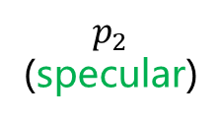
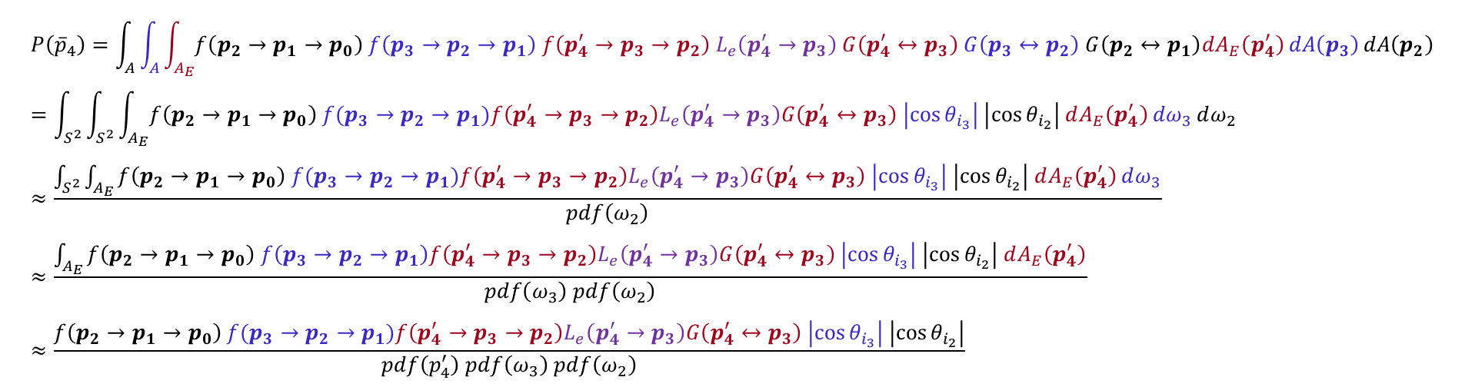




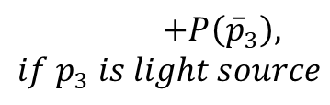



混合两种渲染方程
$$L=P\left({\overline{p}}_{1}\right)+…$$
$$+P\left({\overline{p}}_{2}\right)$$
$$p_{2}^{′}$$
$$p_{0}$$
$$p_{3}^{′}$$
$$+P\left({\overline{p}}_{4}\right)$$
$$p_{1}$$
$$ω_{2}$$
$$p_{4}^{′}$$
$$+P\left({\overline{p}}_{5}\right)$$
$$p_{2}$$
(specular)
$$ω_{3}$$
$$p_{5}^{′}$$
$$p_{3}$$
$$L\left(p_{1}→p_{0}\right)=L_{e}\left(p_{1}^{′}→p_{0}\right) \\ +\int_{A_{E}}{L_{e}\left(p_{2}^{′}→p_{1}\right) f\left(p_{2}^{′}→p_{1}→p_{0}\right) G\left(p_{2}^{′}↔p_{1}\right) dA_{E}\left(p_{2}^{′}\right)} \\ +\int_{A}{\int_{A_{E}}{f\left(p_{2}→p_{1}→p_{0}\right) f\left(p_{3}^{′}→p_{2}→p_{1}\right) L_{e}\left(p_{3}^{′}→p_{2}\right) G\left(p_{3}^{′}↔p_{2}\right) G\left(p_{2}↔p_{1}\right) dA_{E}\left(p_{3}^{′}\right)}dA\left(p_{2}\right)} \\ +\int_{A}{\int_{A}{\int_{A_{E}}{f\left(p_{2}→p_{1}→p_{0}\right) f\left(p_{3}→p_{2}→p_{1}\right) f\left(p_{4}^{′}→p_{3}→p_{2}\right) L_{e}\left(p_{4}^{′}→p_{3}\right) G\left(p_{4}^{′}↔p_{3}\right) G\left(p_{3}↔p_{2}\right) G\left(p_{2}↔p_{1}\right) dA_{E}\left(p_{4}^{′}\right)}dA\left(p_{3}\right)}dA\left(p_{2}\right)} \\ +…$$
=> $P\left({\overline{p}}_{1}\right)$
$$p_{4}$$
$$+P\left({\overline{p}}_{3}\right), if p_{3} is light source$$
$$……$$
$$p_{5}$$
$P\left({\overline{p}}_{2}\right)$ <=
$P\left({\overline{p}}_{3}\right)$ <=
$P\left({\overline{p}}_{4}\right)$ <=
$\sum_{i=5}^{+∞}{P({\overline{p}}_{i})}$<=
$$P\left({\overline{p}}_{4}\right)=\int_{A}{\int_{A}{\int_{A_{E}}{f\left(p_{2}→p_{1}→p_{0}\right) f\left(p_{3}→p_{2}→p_{1}\right) f\left(p_{4}^{′}→p_{3}→p_{2}\right) L_{e}\left(p_{4}^{′}→p_{3}\right) G\left(p_{4}^{′}↔p_{3}\right) G\left(p_{3}↔p_{2}\right) G\left(p_{2}↔p_{1}\right)dA_{E}\left(p_{4}^{′}\right)}dA\left(p_{3}\right)}dA\left(p_{2}\right)} \\ =\int_{S^{2}}{\int_{S^{2}}{\int_{A_{E}}{f\left({p_{2}→p}_{1}→p_{0}\right) f(p_{3}→p_{2}→p_{1})f\left(p_{4}^{′}→p_{3}→p_{2}\right)L_{e}\left(p_{4}^{′}→p_{3}\right)G\left(p_{4}^{′}↔p_{3}\right) \left|\cos{θ_{i_{3}}}\right| \left|\cos{θ_{i_{2}}}\right| dA_{E}\left(p_{4}^{′}\right)}dω_{3}}dω_{2}} \\ ≈\frac{\int_{S^{2}}{\int_{A_{E}}{f\left({p_{2}→p}_{1}→p_{0}\right) f(p_{3}→p_{2}→p_{1})f\left(p_{4}^{′}→p_{3}→p_{2}\right)L_{e}\left(p_{4}^{′}→p_{3}\right)G\left(p_{4}^{′}↔p_{3}\right) \left|\cos{θ_{i_{3}}}\right| \left|\cos{θ_{i_{2}}}\right| dA_{E}\left(p_{4}^{′}\right)}dω_{3}}}{pdf\left(ω_{2}\right)} \\ ≈\frac{\int_{A_{E}}{f\left({p_{2}→p}_{1}→p_{0}\right) f\left(p_{3}→p_{2}→p_{1}\right)f\left(p_{4}^{′}→p_{3}→p_{2}\right)L_{e}\left(p_{4}^{′}→p_{3}\right)G\left(p_{4}^{′}↔p_{3}\right) \left|\cos{θ_{i_{3}}}\right| \left|\cos{θ_{i_{2}}}\right| dA_{E}\left(p_{4}^{′}\right)}}{pdf\left(ω_{3}\right) pdf\left(ω_{2}\right)} \\ ≈\frac{f\left({p_{2}→p}_{1}→p_{0}\right) f(p_{3}→p_{2}→p_{1})f\left(p_{4}^{′}→p_{3}→p_{2}\right)L_{e}\left(p_{4}^{′}→p_{3}\right)G\left(p_{4}^{′}↔p_{3}\right) \left|\cos{θ_{i_{3}}}\right| \left|\cos{θ_{i_{2}}}\right|}{pdf\left(p_{4}^{′}\right) pdf\left(ω_{3}\right) pdf\left(ω_{2}\right)}$$

Slide 16
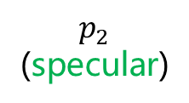

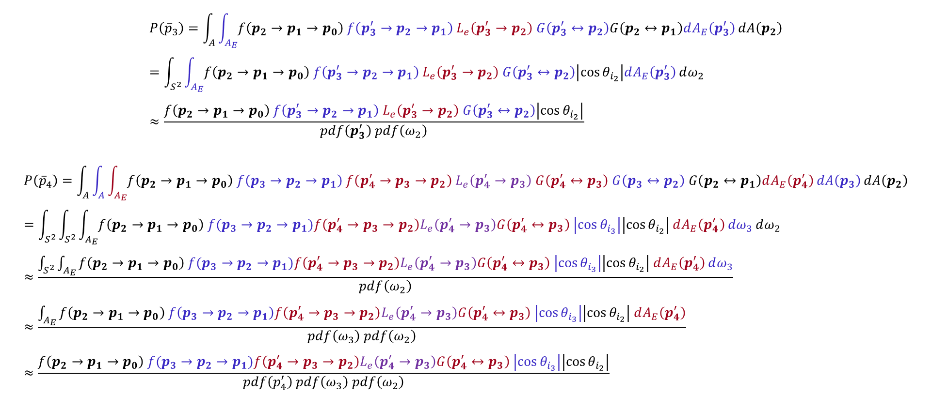
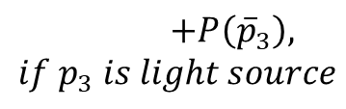

混合两种渲染方程
$$L=P\left({\overline{p}}_{1}\right)+…$$
$$+P\left({\overline{p}}_{2}\right)$$
$$p_{0}$$
$$p_{2}^{′}$$
$$p_{3}^{′}$$
$$+P\left({\overline{p}}_{4}\right)$$
$$p_{1}$$
$$ω_{2}$$
$$p_{4}^{′}$$
$$+P\left({\overline{p}}_{5}\right)$$
$$p_{2}$$
(specular)
$$ω_{3}$$
$$p_{5}^{′}$$
$$p_{3}$$
$$p_{4}$$
$$……$$
$$+P\left({\overline{p}}_{3}\right), if p_{3} is light source$$
$$p_{5}$$
$$P\left({\overline{p}}_{3}\right)=\int_{A}{\int_{A_{E}}{f\left(p_{2}→p_{1}→p_{0}\right) f\left(p_{3}^{′}→p_{2}→p_{1}\right) L_{e}\left(p_{3}^{′}→p_{2}\right) G\left(p_{3}^{′}↔p_{2}\right)G\left(p_{2}↔p_{1}\right)dA_{E}\left(p_{3}^{′}\right)}dA\left(p_{2}\right)} \\ =\int_{S^{2}}{\int_{A_{E}}{f\left(p_{2}→p_{1}→p_{0}\right) f\left(p_{3}^{′}→p_{2}→p_{1}\right) L_{e}\left(p_{3}^{′}→p_{2}\right) G\left(p_{3}^{′}↔p_{2}\right)\left|\cos{θ_{i_{2}}}\right|dA_{E}\left(p_{3}^{′}\right)}dω_{2}} \\ ≈\frac{f\left(p_{2}→p_{1}→p_{0}\right) f\left(p_{3}^{′}→p_{2}→p_{1}\right) L_{e}\left(p_{3}^{′}→p_{2}\right) G\left(p_{3}^{′}↔p_{2}\right)\left|\cos{θ_{i_{2}}}\right|}{pdf\left(p_{3}^{′}\right) pdf\left(ω_{2}\right)}$$
$$P\left({\overline{p}}_{4}\right)=\int_{A}{\int_{A}{\int_{A_{E}}{f\left(p_{2}→p_{1}→p_{0}\right) f\left(p_{3}→p_{2}→p_{1}\right) f\left(p_{4}^{′}→p_{3}→p_{2}\right) L_{e}\left(p_{4}^{′}→p_{3}\right) G\left(p_{4}^{′}↔p_{3}\right) G\left(p_{3}↔p_{2}\right) G\left(p_{2}↔p_{1}\right)dA_{E}\left(p_{4}^{′}\right)}dA\left(p_{3}\right)}dA\left(p_{2}\right)} \\ =\int_{S^{2}}{\int_{S^{2}}{\int_{A_{E}}{f\left({p_{2}→p}_{1}→p_{0}\right) f(p_{3}→p_{2}→p_{1})f\left(p_{4}^{′}→p_{3}→p_{2}\right)L_{e}\left(p_{4}^{′}→p_{3}\right)G\left(p_{4}^{′}↔p_{3}\right) \left|\cos{θ_{i_{3}}}\right|\left|\cos{θ_{i_{2}}}\right| dA_{E}\left(p_{4}^{′}\right)}dω_{3}}dω_{2}} \\ ≈\frac{\int_{S^{2}}{\int_{A_{E}}{f\left({p_{2}→p}_{1}→p_{0}\right) f(p_{3}→p_{2}→p_{1})f\left(p_{4}^{′}→p_{3}→p_{2}\right)L_{e}\left(p_{4}^{′}→p_{3}\right)G\left(p_{4}^{′}↔p_{3}\right) \left|\cos{θ_{i_{3}}}\right|\left|\cos{θ_{i_{2}}}\right| dA_{E}\left(p_{4}^{′}\right)}dω_{3}}}{pdf\left(ω_{2}\right)} \\ ≈\frac{\int_{A_{E}}{f\left({p_{2}→p}_{1}→p_{0}\right) f\left(p_{3}→p_{2}→p_{1}\right)f\left(p_{4}^{′}→p_{3}→p_{2}\right)L_{e}\left(p_{4}^{′}→p_{3}\right)G\left(p_{4}^{′}↔p_{3}\right) \left|\cos{θ_{i_{3}}}\right|\left|\cos{θ_{i_{2}}}\right| dA_{E}\left(p_{4}^{′}\right)}}{pdf\left(ω_{3}\right) pdf\left(ω_{2}\right)} \\ ≈\frac{f\left({p_{2}→p}_{1}→p_{0}\right) f(p_{3}→p_{2}→p_{1})f\left(p_{4}^{′}→p_{3}→p_{2}\right)L_{e}\left(p_{4}^{′}→p_{3}\right)G\left(p_{4}^{′}↔p_{3}\right) \left|\cos{θ_{i_{3}}}\right|\left|\cos{θ_{i_{2}}}\right|}{pdf\left(p_{4}^{′}\right) pdf\left(ω_{3}\right) pdf\left(ω_{2}\right)}$$

Slide 17
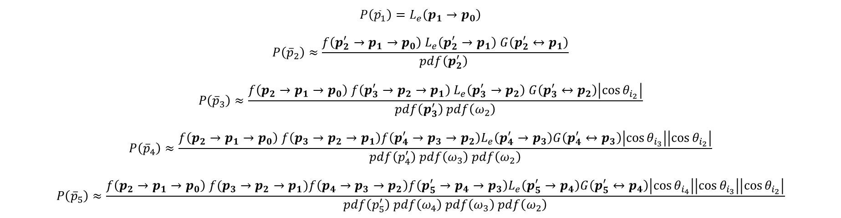
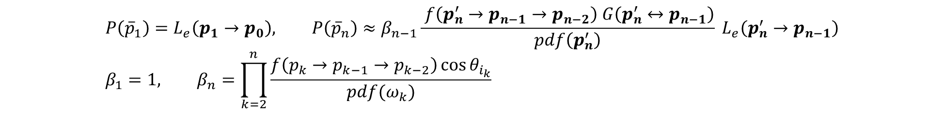
混合两种渲染方程
$$L=P\left({\overline{p}}_{1}\right)+…$$
$$+P\left({\overline{p}}_{2}\right)$$
$$p_{0}$$
$$p_{2}^{′}$$
$$p_{3}^{′}$$
$$+P\left({\overline{p}}_{4}\right)$$
$$p_{1}$$
$$ω_{2}$$
$$p_{4}^{′}$$
$$+P\left({\overline{p}}_{5}\right)$$
$$p_{2}$$
(specular)
$$ω_{3}$$
$$p_{5}^{′}$$
$$p_{3}$$
$$p_{4}$$
$$……$$
$$+P\left({\overline{p}}_{3}\right), if p_{3} is light source$$
$$p_{5}$$
$$P\left({\overline{p}}_{1}\right)=L_{e}\left(p_{1}→p_{0}\right)$$
$$P\left({\overline{p}}_{2}\right)≈\frac{f\left(p_{2}^{′}→p_{1}→p_{0}\right) L_{e}\left(p_{2}^{′}→p_{1}\right) G\left(p_{2}^{′}↔p_{1}\right)}{pdf\left(p_{2}^{′}\right) }$$
$$P\left({\overline{p}}_{3}\right)≈\frac{f\left(p_{2}→p_{1}→p_{0}\right) f\left(p_{3}^{′}→p_{2}→p_{1}\right) L_{e}\left(p_{3}^{′}→p_{2}\right) G\left(p_{3}^{′}↔p_{2}\right)\left|\cos{θ_{i_{2}}}\right|}{pdf\left(p_{3}^{′}\right) pdf\left(ω_{2}\right)}$$
$$P\left({\overline{p}}_{4}\right)≈\frac{f\left({p_{2}→p}_{1}→p_{0}\right) f\left(p_{3}→p_{2}→p_{1}\right)f\left(p_{4}^{′}→p_{3}→p_{2}\right)L_{e}\left(p_{4}^{′}→p_{3}\right)G\left(p_{4}^{′}↔p_{3}\right)\left|\cos{θ_{i_{3}}}\right|\left|\cos{θ_{i_{2}}}\right|}{pdf\left(p_{4}^{′}\right) pdf\left(ω_{3}\right) pdf\left(ω_{2}\right)}$$
$$P\left({\overline{p}}_{5}\right)≈\frac{f\left({p_{2}→p}_{1}→p_{0}\right) f(p_{3}→p_{2}→p_{1})f\left(p_{4}→p_{3}→p_{2}\right)f\left(p_{5}^{′}→p_{4}→p_{3}\right)L_{e}\left(p_{5}^{′}→p_{4}\right)G\left(p_{5}^{′}↔p_{4}\right)\left|\cos{θ_{i_{4}}}\right|\left|\cos{θ_{i_{3}}}\right|\left|\cos{θ_{i_{2}}}\right|}{pdf\left(p_{5}^{′}\right) pdf\left(ω_{4}\right) pdf\left(ω_{3}\right) pdf\left(ω_{2}\right)}$$
$$P\left({\overline{p}}_{1}\right)=L_{e}\left(p_{1}→p_{0}\right), P\left({\overline{p}}_{n}\right)≈β_{n−1}\frac{ f\left(p_{n}^{′}→p_{n−1}→p_{n−2}\right) G\left(p_{n}^{′}↔p_{n−1}\right)}{pdf\left(p_{n}^{′}\right)} L_{e}\left(p_{n}^{′}→p_{n−1}\right) \\ β_{1}=1, β_{n}=\prod_{k=2}^{n}{\frac{f\left(p_{k}→p_{k−1}→p_{k−2}\right)\cos{θ_{i_{k}}}}{pdf(ω_{k})}}$$

Slide 18
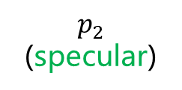

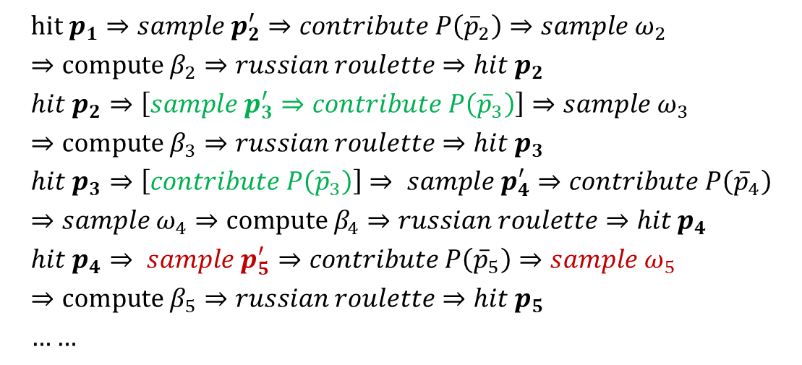
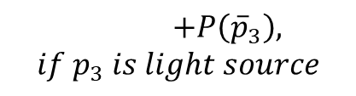
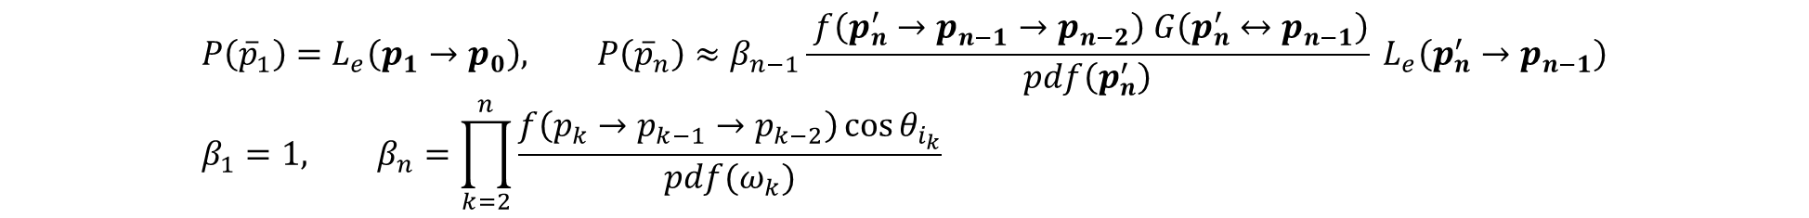



路径追踪流程
$$P\left({\overline{p}}_{1}\right)=L_{e}\left(p_{1}→p_{0}\right), P\left({\overline{p}}_{n}\right)≈β_{n−1}\frac{ f\left(p_{n}^{′}→p_{n−1}→p_{n−2}\right) G\left(p_{n}^{′}↔p_{n−1}\right)}{pdf\left(p_{n}^{′}\right)} L_{e}\left(p_{n}^{′}→p_{n−1}\right) \\ β_{1}=1, β_{n}=\prod_{k=2}^{n}{\frac{f\left(p_{k}→p_{k−1}→p_{k−2}\right)\cos{θ_{i_{k}}}}{pdf(ω_{k})}}$$
$$L=P\left({\overline{p}}_{1}\right)+…$$
$$+P\left({\overline{p}}_{2}\right)$$
$$p_{2}^{′}$$
$$hit p_{1}⇒sample p_{2}^{′}⇒contribute P\left({\overline{p}}_{2}\right)⇒sample ω_{2}⇒compute β_{2}⇒russian roulette⇒hit p_{2} \\ hit p_{2}⇒\left[sample p_{3}^{′}⇒contribute P\left({\overline{p}}_{3}\right)\right]⇒sample ω_{3}⇒compute β_{3}⇒russian roulette⇒hit p_{3} \\ hit p_{3}⇒\left[contribute P\left({\overline{p}}_{3}\right)\right]⇒ sample p_{4}^{′}⇒contribute P\left({\overline{p}}_{4}\right)⇒sample ω_{4}⇒compute β_{4}⇒russian roulette⇒hit p_{4} \\ hit p_{4}⇒ sample p_{5}^{′}⇒contribute P\left({\overline{p}}_{5}\right)⇒sample ω_{5}⇒compute β_{5}⇒russian roulette⇒hit p_{5} \\ ……$$
$$p_{0}$$
$$p_{3}^{′}$$
$$+P\left({\overline{p}}_{4}\right)$$
$$p_{1}$$
$$ω_{2}$$
$$p_{4}^{′}$$
$$+P\left({\overline{p}}_{5}\right)$$
$$p_{2}$$
(specular)
$$ω_{3}$$
$$p_{5}^{′}$$
$$p_{3}$$
$$ω_{4}$$
$$p_{4}$$
$$ω_{5}$$
$$……$$
$$+P\left({\overline{p}}_{3}\right), if p_{3} is light source$$
$$p_{5}$$

Slide 19

如何采样$p_{n}^{′}$？
1.采样光源（根据光源的功率（Φ），进行重要性采样）
2.在光源上获取采样点
$$pdf\left(p_{n}^{′}\right)=pdf\left(light_{i}\right)∗pdf\left(p_{n}^{′}|light_{i}\right)$$
$$L_{e}\left(p_{n}^{′}→p_{n−1}\right)$$

Slide 20
采样离散分布 —— 直接采样，O(n)
Item | A | B | C | D
P | 0.5 | 0.25 | 0.125 | 0.125
u = UniformSample()
sum = 0
for item in items:
sum += item.prob
if sum > u:
return item

Slide 21
采样离散分布 —— Alias Table，O(1)
Item | A | B | C | D
P | 0.5 | 0.25 | 0.125 | 0.125
Item | A | B | C | D
Index | 0 | 1 | 2 | 3
Q | 1 | 1 | 0.5 | 0.5
Alias | -1 | -1 | 0 | 0
idx = floor(UniformSample() * item_number)
item = items[idx]
if UniformSample() < item.q:
return item
return items[item.alias]

Slide 22
初始化Alias Table
Item | A | B | C | D
P | 0.5 | 0.25 | 0.125 | 0.125
Item | A | B | C | D
Index | 0 | 1 | 2 | 3
Q | 1 | 1 | 1 | 1
Alias | -1 | -1 | -1 | -1
先将所有的P乘上item_number，使得P的均值为1
Item | A | B | C | D
P | 2 | 1 | 0.5 | 0.5
将所有item分成两部分，一部分的P小于1，另一部分的P大于1。

Slide 23
初始化Alias Table
Item | A | B | C | D
Index | 0 | 1 | 2 | 3
Q | 1 | 1 | 1 | 1
Alias | -1 | -1 | -1 | -1
P | 2 | 1 | 0.5 | 0.5
Less: C、D Greater：A
从Less中取一个item_l，从Greater取一个item_ge
item_l.Q = item_l.P
item_l.alias = item_ge.index
item_ge.P -= 1 – item_l.Q
根据item_ge.P，重新放入Less或Greater中
Item | A | B | C | D
Index | 0 | 1 | 2 | 3
Q | 1 | 1 | 0.5 | 1
Alias | -1 | -1 | 0 | -1
P | 1.5 | 1 | 0.5 | 0.5

Slide 24
初始化Alias Table
Item | A | B | C | D
Index | 0 | 1 | 2 | 3
Q | 1 | 1 | 0.5 | 1
Alias | -1 | -1 | 0 | -1
P | 1.5 | 1 | 0.5 | 0.5
Less: D Greater：A
从Less中取一个item_l，从Greater取一个item_ge
item_l.Q = item_l.P
item_l.alias = item_ge.index
item_ge.P -= 1 – item_l.Q
根据item_ge.P，重新放入Less或Greater中
Item | A | B | C | D
Index | 0 | 1 | 2 | 3
Q | 1 | 1 | 0.5 | 0.5
Alias | -1 | -1 | 0 | 0
P | 1 | 1 | 0.5 | 0.5

Slide 25

计算光源的功率Φ —— 面积光 AreaLight
$$φ=2\int_{A}{EdA}=2EA, E=\int_{H^{2}}{L\cos{θ}dω}, dω=\sin{θ}dθdφ$$
$$E=L\int_{0}^{2π}{\int_{0}^{\frac{π}{2}}{cosθ\sin{θ}dθ}dφ} \\ =2π \frac{L}{2}\int_{0}^{\frac{π}{2}}{\sin{2θ}dθ} \\ =πL\left(−\frac{\cos{2θ}}{2}{\left.​\right|}_{0}^{\frac{π}{2}}\right)=πL$$
$$φ=2πAL$$

Slide 26

计算光源的功率Φ —— 无限光 InfiniteLight
$$φ=\int_{A}{EdA}=EA=4EπR^{2}, E=\int_{H^{2}}{L\cos{θ}dω}, dω=\sin{θ}dθdφ$$
$$E=L\int_{0}^{2π}{\int_{0}^{\frac{π}{2}}{cosθ\sin{θ}dθ}dφ} \\ =2π \frac{L}{2}\int_{0}^{\frac{π}{2}}{\sin{2θ}dθ} \\ =πL\left(−\frac{\cos{2θ}}{2}{\left.​\right|}_{0}^{\frac{π}{2}}\right)=πL$$
$$φ=4π^{2}R^{2}L$$

Slide 27
在光源上获取采样点 —— 光源的分类
面积光 AreaLight
面积光是由Shape发出的光，只需要对Shape进行采样即可
无限光 InfiniteLight
无限光也是环境光，在创建完场景后，需要根据包围整个场景的包围盒，计算得出场景的最大包围球，而后在这个球上进行采样即可。

Slide 28
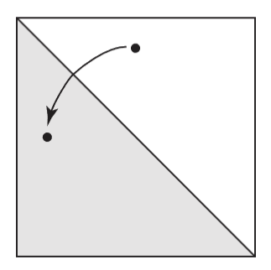






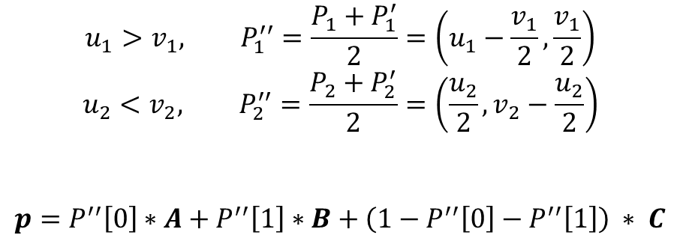
均匀采样三角形
$$P_{2}\left(u_{2},v_{2}\right)$$
$$P_{2}^{′′}$$
$$P_{1}\left(u_{1},v_{1}\right)$$
$$u_{1}>v_{1}, P_{1}^{′′}=\frac{P_{1}+P_{1}^{′}}{2}=\left(u_{1}−\frac{v_{1}}{2},\frac{v_{1}}{2}\right)$$
$$u_{2}<v_{2}, P_{2}^{′′}=\frac{P_{2}+P_{2}^{′}}{2}=\left(\frac{u_{2}}{2},v_{2}−\frac{u_{2}}{2}\right)$$
$$p=P^{′′}\left[0\right]∗A+P^{′′}\left[1\right]∗B+\left(1−P^{′′}\left[0\right]−P^{′′}\left[1\right]\right) ∗ C$$
$$P_{2}^{′}\left(0,v_{2}−u_{2}\right)$$
$$P_{1}^{′′}$$
$$P_{1}^{′}\left(u_{1}−v_{1},0\right)$$

